Slide 1
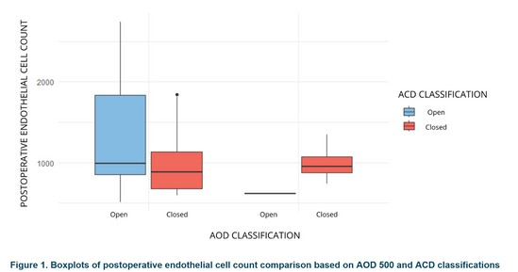
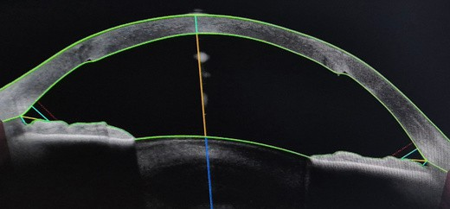
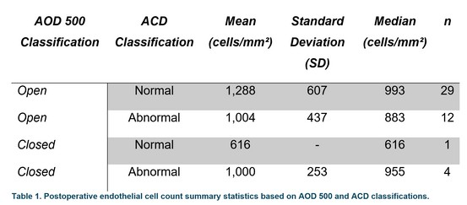
125 - A0241
Comparison of Endothelial Cell Count Before and After Penetrating Keratoplasty: Analysis by Iridocorneal Angle Configuration
Guardado-Valdez J. Montoya-Guardiola G, Fernández-Vizcaya O. Alegría-Martínez J. Hurtado-Noriega E. Leija-Torres A. Cornea Department. Fundación Hospital Nuestra Señora de la Luz, Mexico City.
Purpose: This study explores the relationship between iridocorneal angle configurations, measured by Angle Opening Distance at 500 microns (AOD 500) and Anterior Chamber Depth (ACD), and changes in endothelial cell density (ECD) pre- and post-penetrating keratoplasty (PK). Understanding this interplay aids in refining surgical planning and optimizing patient outcomes.
Methods: An ambispective cohort design included 76 patients undergoing PK for corneal opacities (2021– 2024). Patients were classified by AOD 500 (open ≥0.25 mm; closed <0.25 mm) and ACD (normal ≥3.11 mm; abnormal <3.11 mm). ECD was measured pre- and postoperatively using specular microscopy. Statistical analyses assessed correlations between ECD changes and visual outcomes, and concordance between AOD 500 and ACD classifications.
Figure 2. OCT-SA Open-angle in a PK patient.
Results: Of 46 patients analyzed, 89.1% had open-angle and 10.9% closed-angle by AOD 500. Concordance between AOD 500 and ACD classifications was low (κ=0.258, p<0.05). Postoperative ECD loss was greater in closed-angle patients. Spearman’s correlations revealed a moderate negative relationship between ECD and visual acuity (ρ=-0.48, p<0.05) and a weaker negative relationship with ECD change (ρ=-0.29, p<0.05). Descriptive analyses highlighted variations in ECD based on combined AOD 500 and ACD classifications.
Conclusion:
Classifying iridocorneal angle morphology via AOD 500 and ACD provides complementary insights into endothelial health and visual prognosis after PK. The results emphasize the need for comprehensive preoperative evaluations to mitigate complications and enhance outcomes. Further research with larger cohorts is warranted to validate these findings.
Author’s email: dr.guardado.cornea@gmail.com

